Slide 1
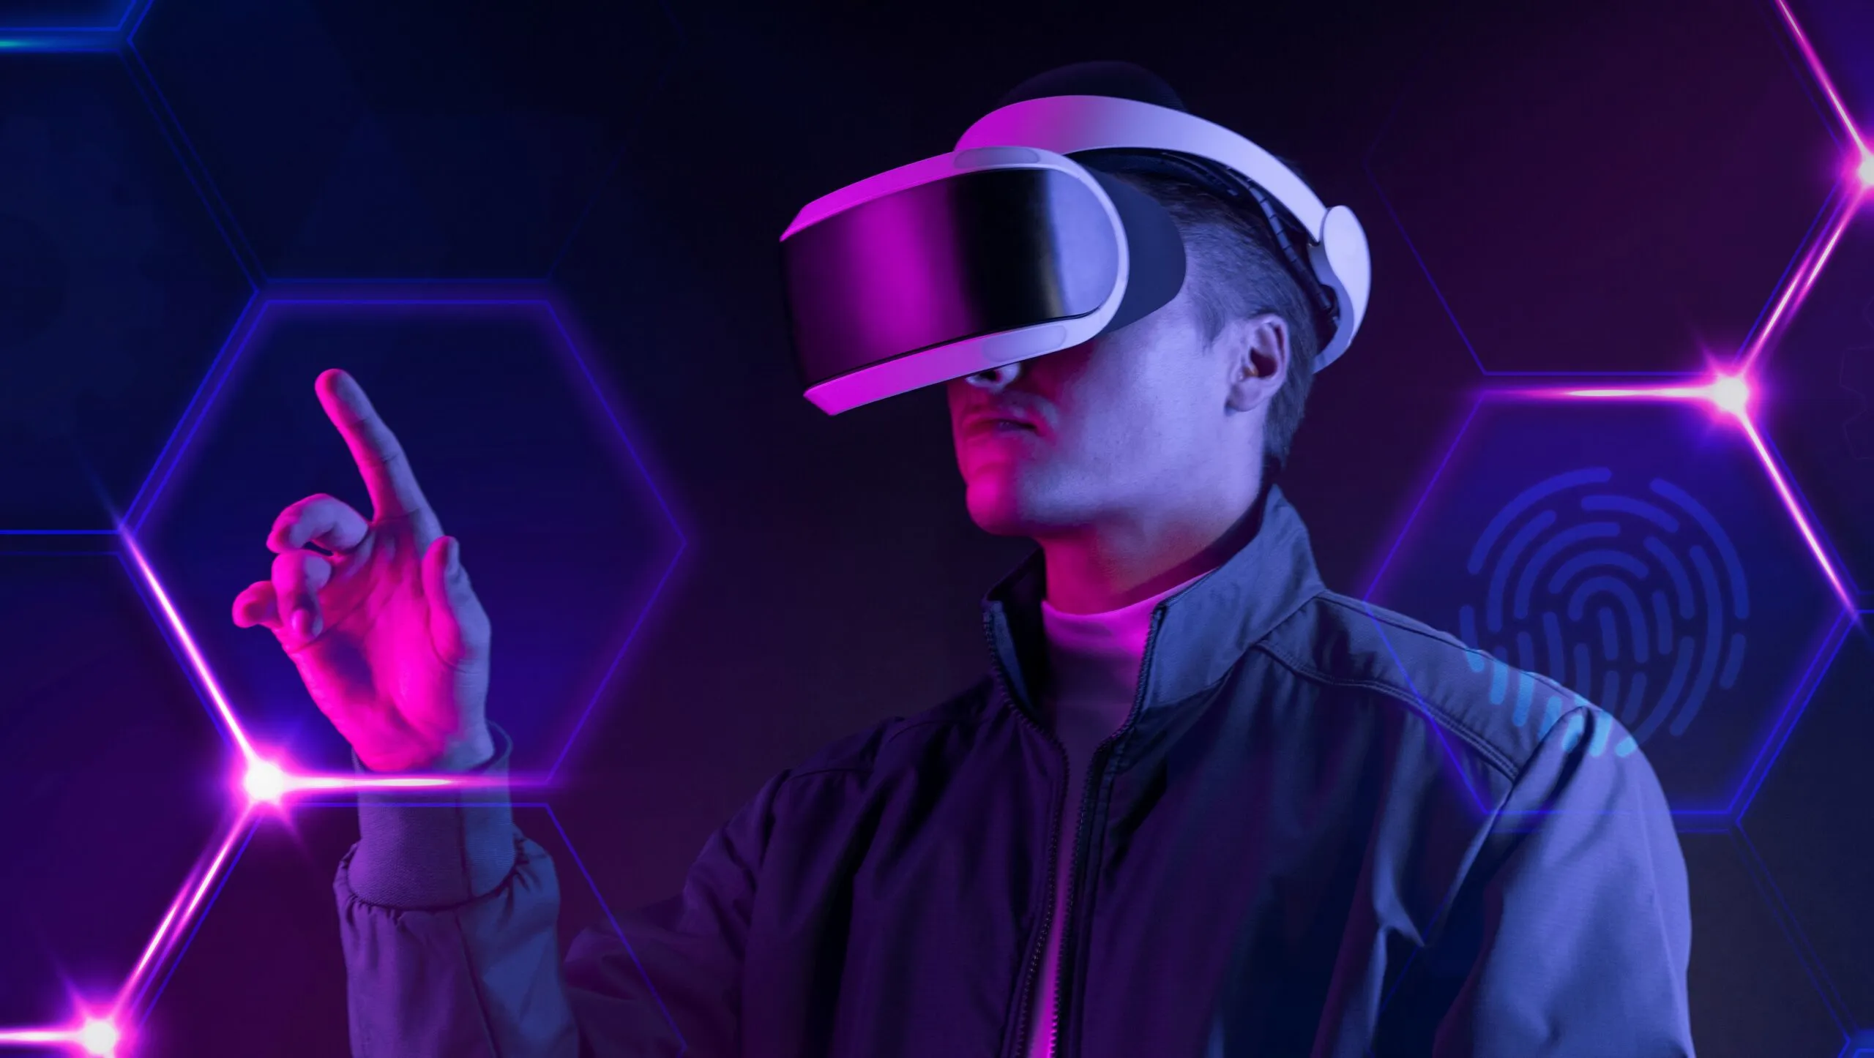
What is Metaverse?
Name : Hamza Sarwar
Roll No : PIAIC202301
Center : UMT (Lahore)
Batch - 39 | Time - 02:00 to 06:00

Slide 2
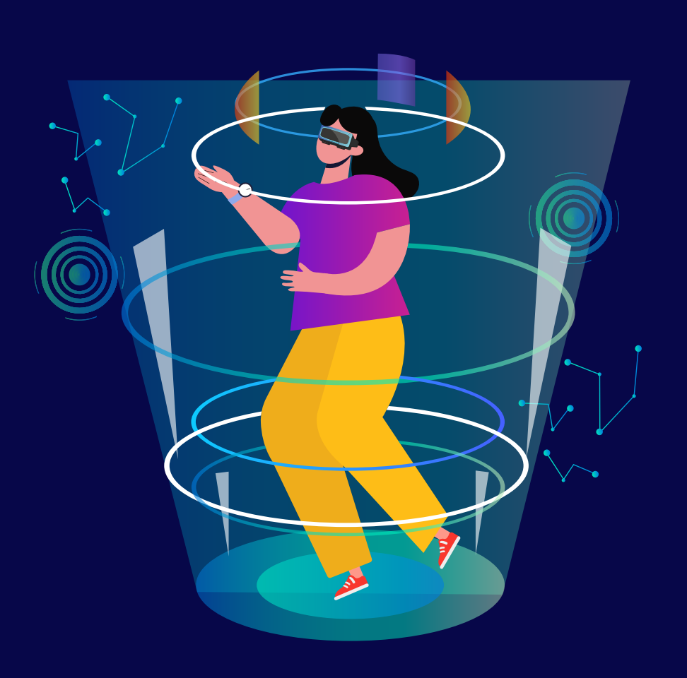
What is Metaverse?
Meta - Greek Word (After / Beyond) Verse - Universe
The Metaverse is a type of digital world or reality combining blockchain technology, social media, online gaming, virtual reality, augmented reality, digital tokens, and assets.
This helps users to fully utilize this virtual space to interact with one another. In addition, virtual reality and augmented reality creates various sensory elements to make the experience more enjoyable for the user. (Term “Metaverse” was coined by Author Neal Stepson in his 1992 novel Snow Crash)

Slide 3
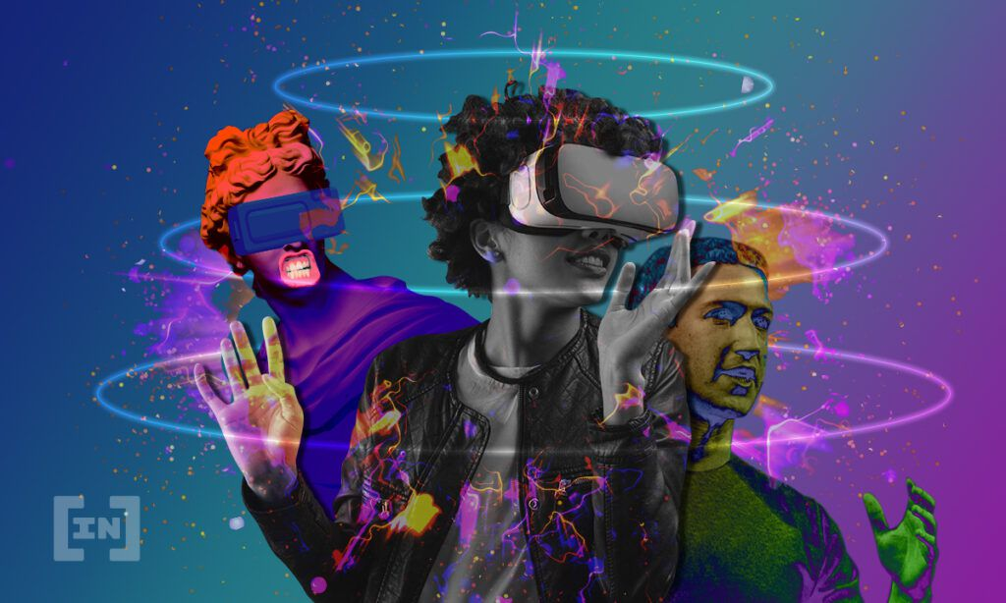
Importance of Metaverse
The experience within the Metaverse can open up new opportunities for individuals and businesses. For example, individuals can showcase their works or sell their services within the Metaverse in full digital form.
It can become a place for entertainment, commerce, workplaces, and even social gathering venues. Users will only need access to the internet to go into the Metaverse.
The Metaverse can be the next phase for the internet where every type of digital experience can be in one place, making it efficient for the users.

Slide 4
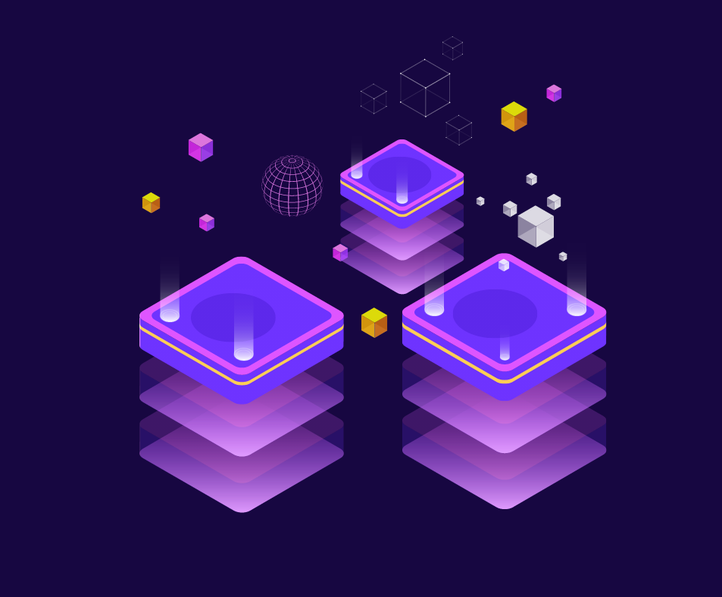
Elements of Metaverse
Web 3.0
NFTs
Games
Blockchain Protocols
Cryptocurrencies/Tokens
Augmented Reality (AR)
Virtual Reality (VR)

Slide 5
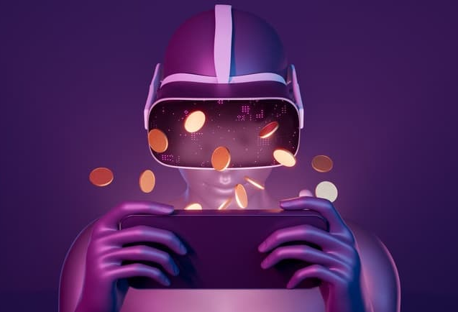
Metaverse and Games
Games are a major part of the Metaverse ecosystem. In Metaverse, the game will not have a centralized model system. It will also come with an internalized economic structure that will help users to buy in-game assets. Unique assets are represented by NFTs, and these assets can be sold on other NFT marketplaces. The users buying these in-game assets will have sole ownership over them.

Slide 6
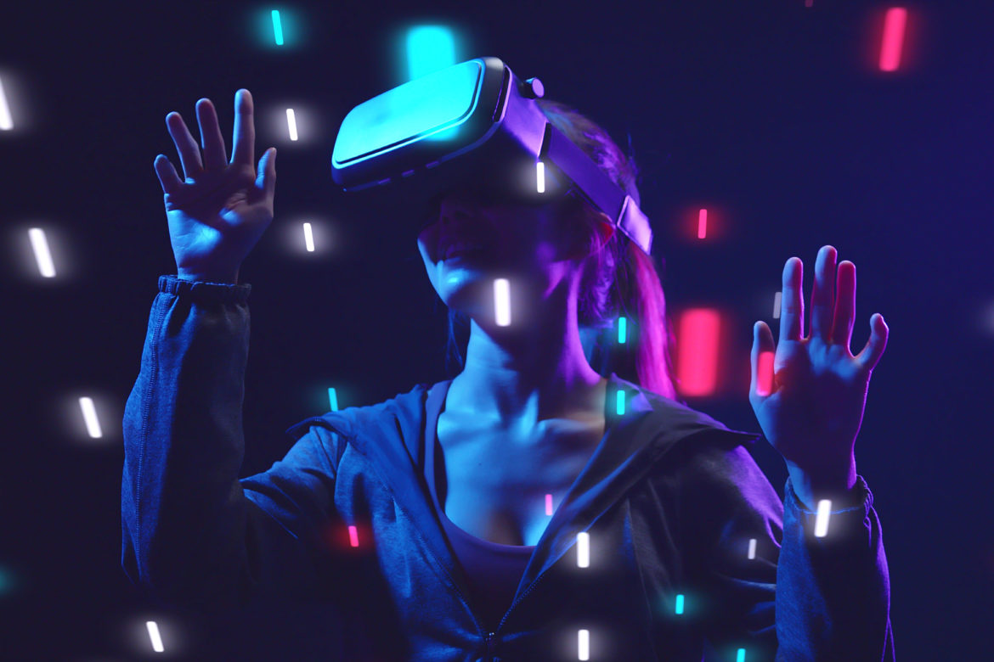
Industries Using Metaverse Technology
Finance
Fashion
Gaming
Marketing
Virtual Shows
Art Galleries
Architecture
Entertainment

